Slide 1
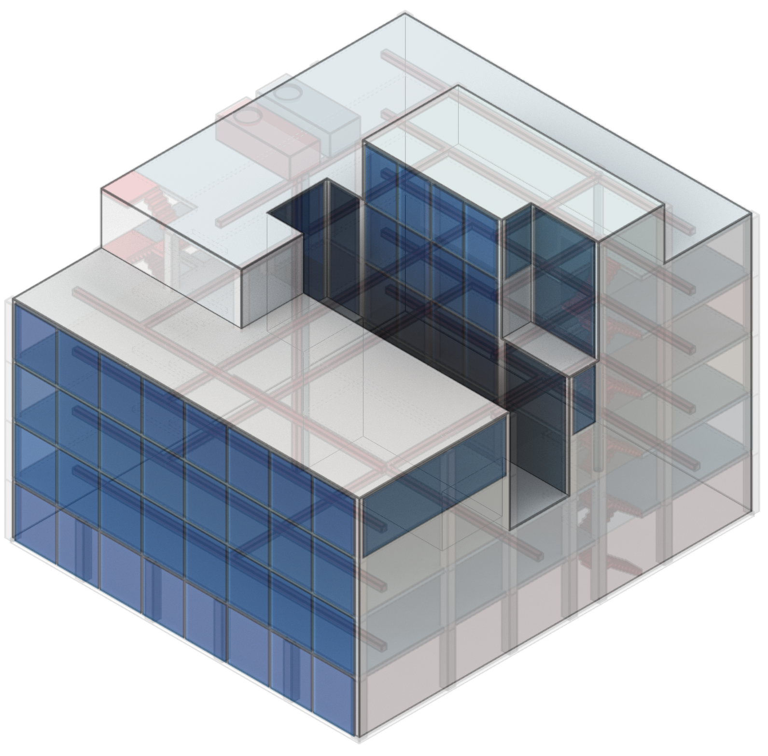
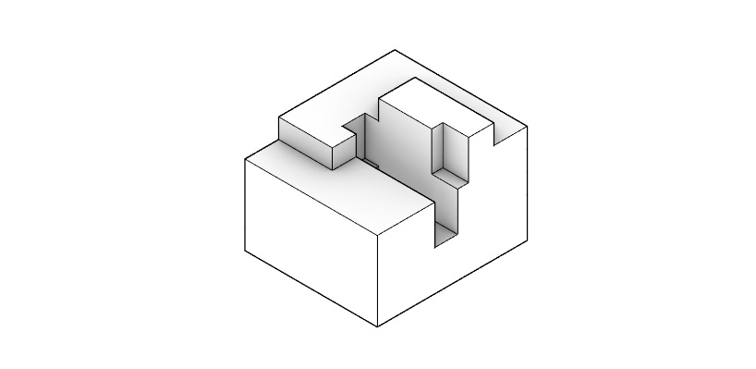
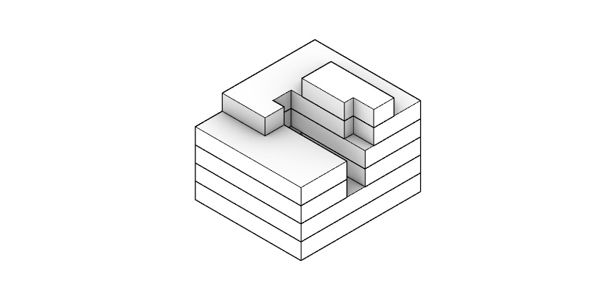
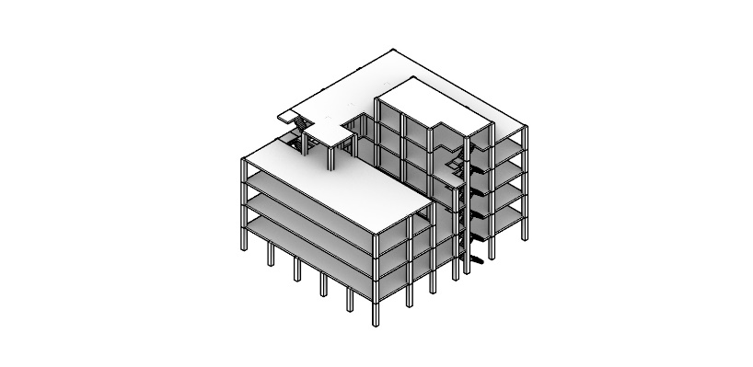
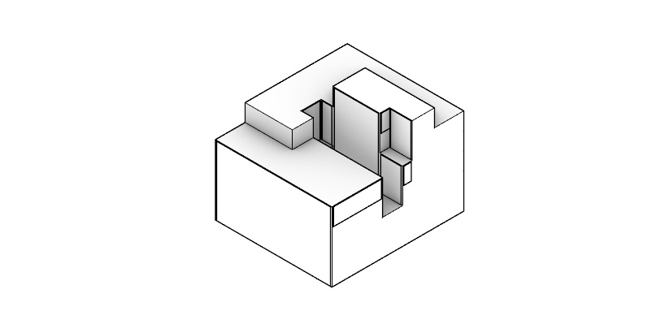
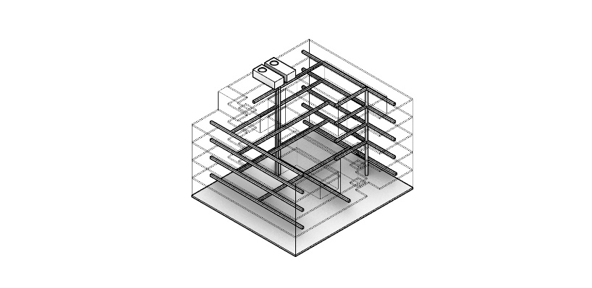
Multiple Design Representations

Slide 2
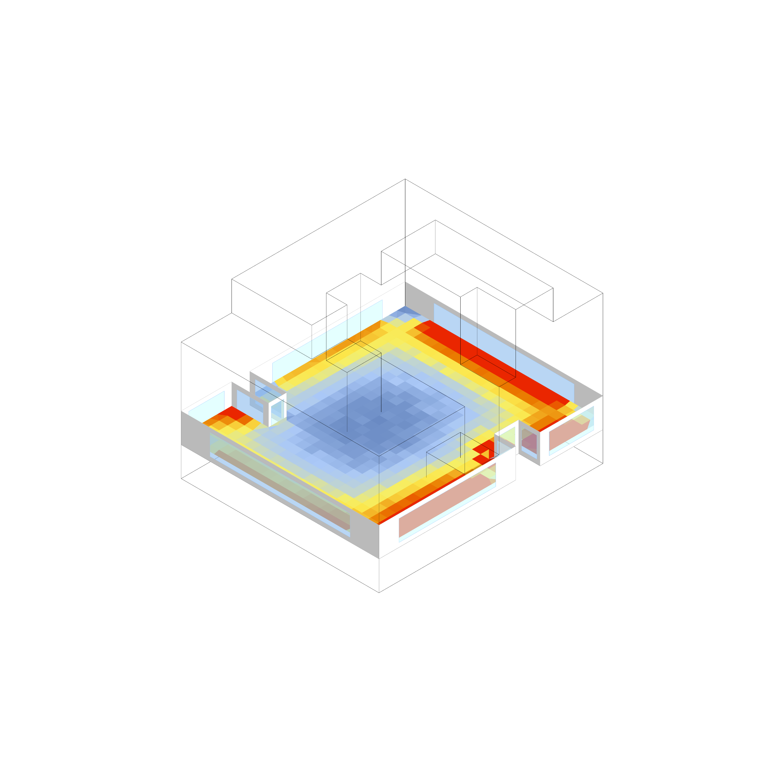
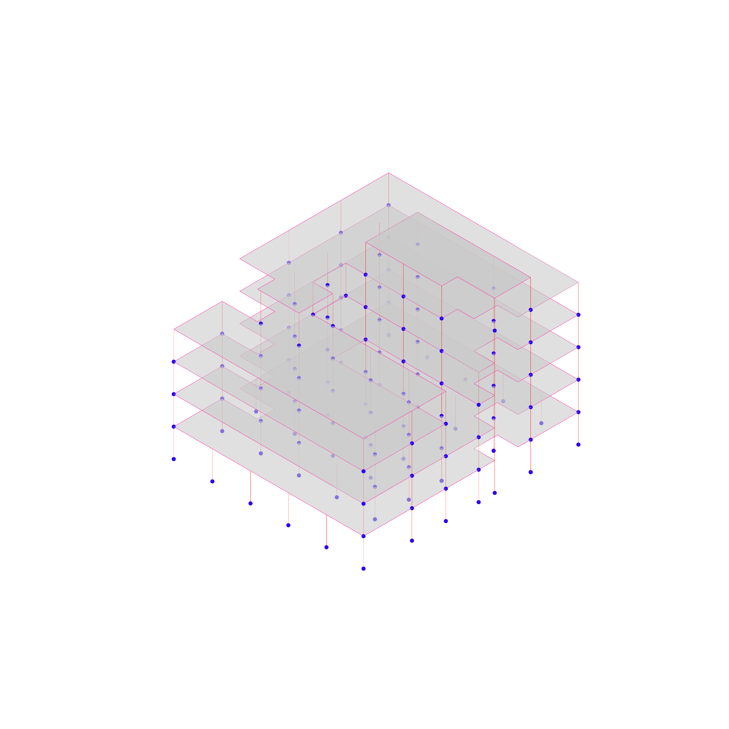
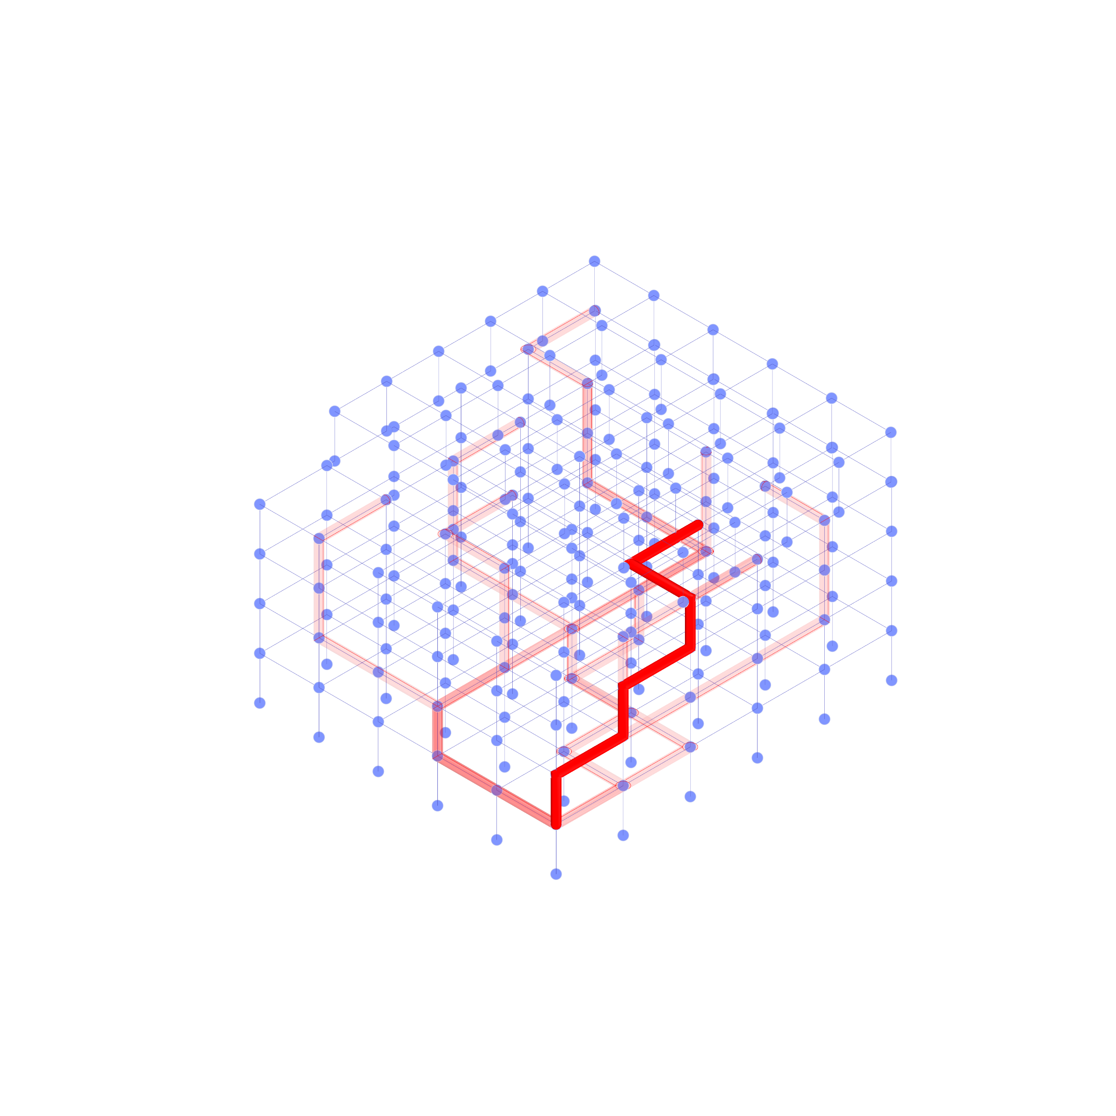
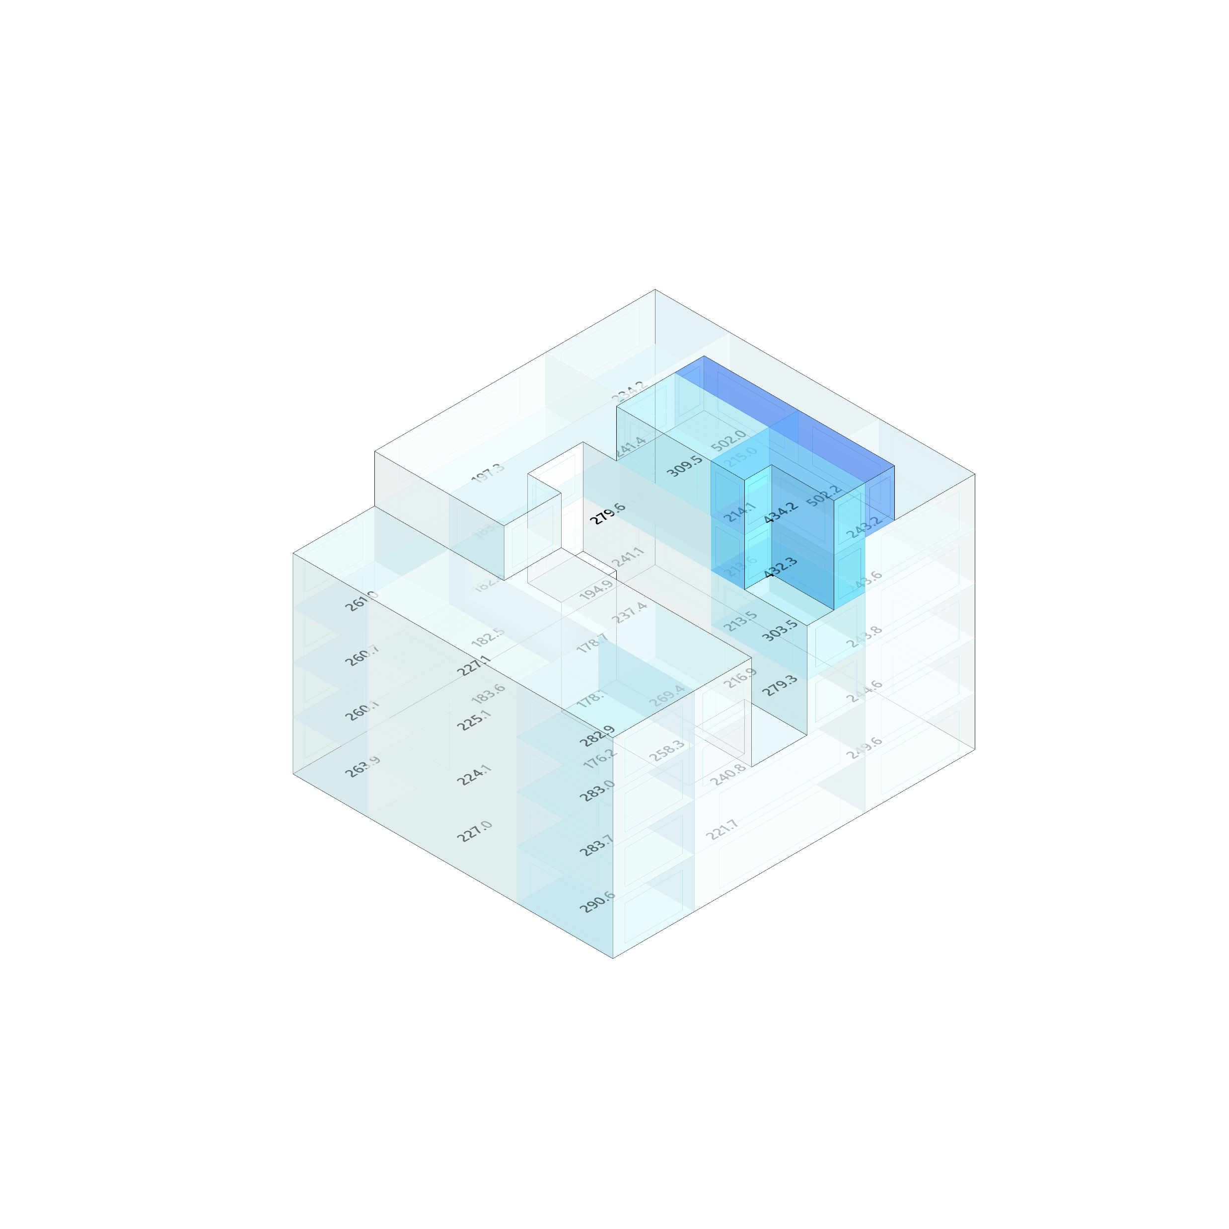
Multiple Design Representations

Slide 3
































Multiple Design Representations

Slide 4
Multiple Design Representations

Slide 5
Multiple Design Representations
There are many different ways to represent design
An unlimited number!
Each depending on the performative question through which we are assessing the design
And yet there is only one design (i.e. one physical building is to be built)
So we require a degree of compatibility between these numerous representations

Slide 6
Concepts
Object – has simple list of defining properties
- instances uniquely identifiable (Guid)
- State uniquely identifiable (Hash)
- Customisable and extendable through Fragments and Custom Data
Properties – Are classified as either:
+ Defining (e.g. BH.oM.Physical.Wall.Surface or Thickness
+ Derived (e.g. BH.oM.Physical.Wall.SurfaceArea
+ Dependant (e.g. BH.oM.Physical.Wall.AdjacentSpace)
Fragments – Objects that can be used as optional properties attached to other objects
- Can be self defining (e.g. Material)
- Can be Relational or dependant on other objects or context (e.g AdapterID)
Element – An object with some form of dimensionality
- See the IElement interfaces in Dimensional_oM

Slide 7
Concepts
Results – xxx
Datasets – Curated Objects
with a Source
Resultsets – Special cases of above Dataset where objects stored are IResults
and Source refers to a IModel instance
Dataset currently stores a list of IBHoMObject

Slide 8
Concepts
Specification – Written against objects defining allowable values for Properties
- These properties can be Defining, Derived or Dependant
- Zones
- Spatial Specification
Spatial Diffing by location…
Representational Diffing (i.e. is the Structure.Panel a compatible representation of the Physical.Floor
ToleranceSpecification coupled against Diffing.Delta (i.e. allowable variance)
Model – A set of compatible Objects and Specifications
- With the means to evaluate the Properties encoded in the Specification
- Requirement for Engine methods or Analysis to be available etc.
excepting of the trivial example of specification against defining properties.

Slide 9
Concepts
Stream – A collection of objects (or Model) that is versioned and changes over time - Recording and referencing its previous states
Workflow – Connected associative, Synchronous chain for operations
Environment – Asynchronous Model/Task manager

Slide 10
Concepts
Option

Slide 11
Common object Model (oM)

Slide 12
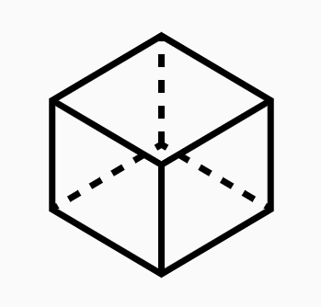

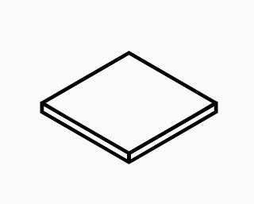


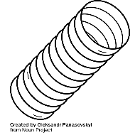


Common object Model (oM)
…
Discrete and discipline specific
+
Compatible and customisable

Slide 13
Common object Model (oM) How to represent a “Wall”
Physical BH.oM.Physical.Elements.Wall
Analytical BH.oM.Facade.Elements.Panel
BH.oM.Structure.Elements.Panel
BH.oM.Environment.Elements.Panel
BH.oM.Acoustic.Elements.Panel
Geometrical BH.oM.Geometry.PlanarSurface
BH.oM.Geometry.NurbsSurface
BH.oM.Geometry.NurbsCurve
Graphical BH.oM.Graphics.RenderMesh

Slide 14


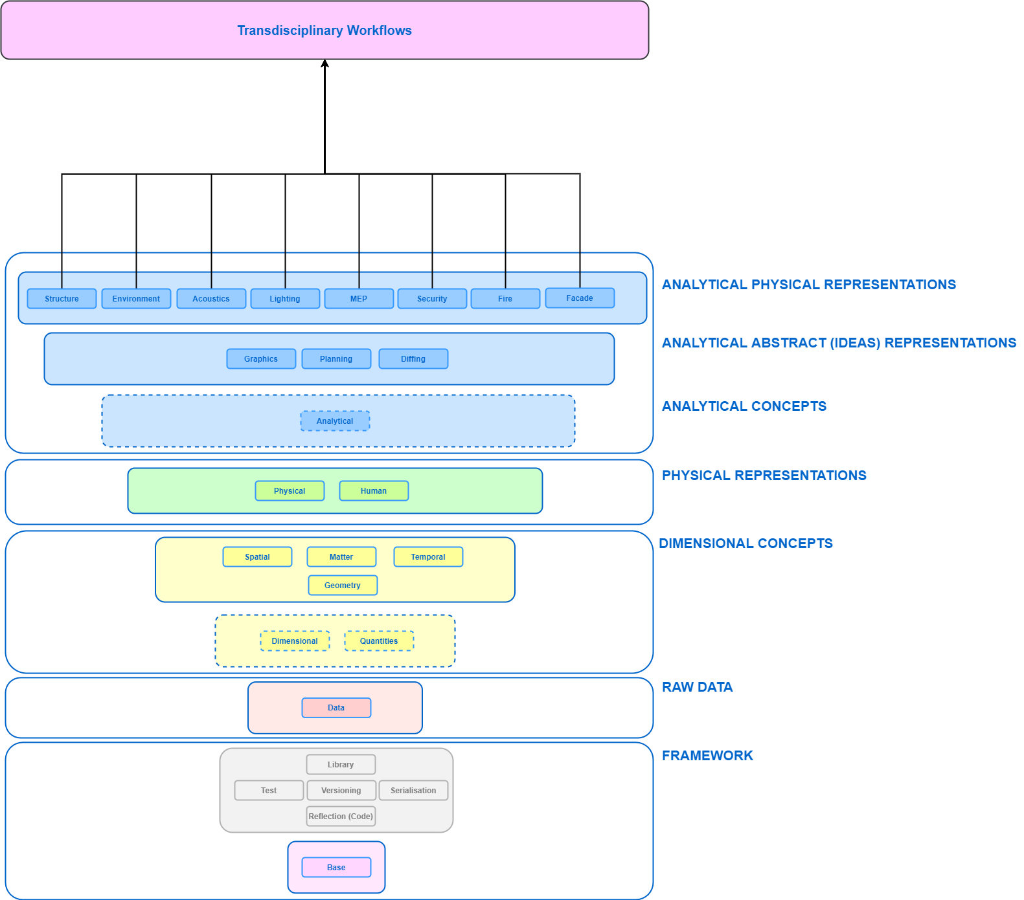
Common object Model (oM)
…
…
Analytical Physical Representations
Abstract Representations
Analytical Concepts
Physical Representations
Dimensional Concepts
Raw Data
Code Framework
Base Object

Slide 15
Key Interfaces
…
…
Elements, Materials, Results
IResult
INode, ILink, IPanel …
IGeometry, ICurve, ISurface …
IElement0D, 1D, 2D …
IBHoMObject

Slide 16
Base BHoM Object
namespace BH.oM.Base
{
public class BHoMObject : IBHoMObject
{
/***************************************************/
/**** Properties ****/
/***************************************************/
public virtual Guid BHoM_Guid { get; set; } = Guid.NewGuid();
public virtual string Name { get; set; } = "";
public virtual FragmentSet Fragments { get; set; } = new FragmentSet();
public virtual HashSet<string> Tags { get; set; } = new HashSet<string>();
public virtual Dictionary<string, object> CustomData { get; set; } = new Dictionary<string, object>();
}
}
https://github.com/BHoM/BHoM/blob/main/BHoM/BHoMObject.cs

Slide 17
Base BHoM Object
namespace BH.oM.Base
{
public class BHoMObject : IBHoMObject
{
/***************************************************/
/**** Properties ****/
/***************************************************/
public virtual Guid BHoM_Guid { get; set; } = Guid.NewGuid();
public virtual string Name { get; set; } = "";
public virtual FragmentSet Fragments { get; set; } = new FragmentSet();
public virtual HashSet<string> Tags { get; set; } = new HashSet<string>();
public virtual Dictionary<string, object> CustomData { get; set; } = new Dictionary<string, object>();
}
}
https://github.com/BHoM/BHoM/blob/main/BHoM/BHoMObject.cs

Slide 18
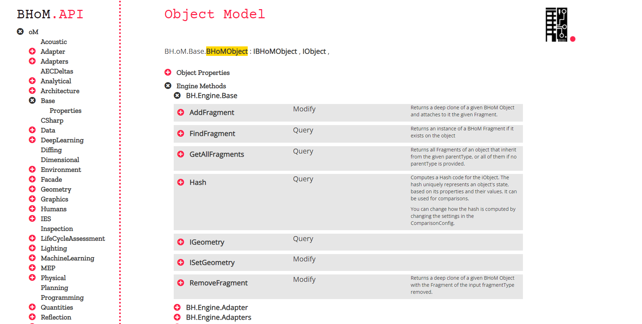
Base BHoM Object
https://bhom.xyz/api/object.html#!?namespace=BH.oM.Base&object=BHoMObject

Slide 19
Base BHoM Object
https://bhom.xyz/api/object.html#!?namespace=BH.oM.Base&object=BHoMObject

Slide 20
Example: Geometry.Circle
namespace BH.oM.Geometry
{
[Description("A plane curve. Standard circle defining a curve of
constant distance from a point, its Centre.")]
public class Circle : ICurve
{
/***************************************************/
/**** Properties ****/
/***************************************************/
[Description("Origin point defining location of the Circle in three-dimensional space.")]
public virtual Point Centre { get; set; } = new Point();
[Description("Vector perpendicular to the plane in which the Circle lies.")]
public virtual Vector Normal { get; set; } = new Vector { X = 0, Y = 0, Z = 1 };
[Length]
[Description("Distance from the Centre to any point on Circle.")]
public virtual double Radius { get; set; } = 0;
https://github.com/BHoM/BHoM/blob/main/Geometry_oM/Curve/Circle.cs

Slide 21
Example: Geometry.Circle
Simply, the name of the object (e.g. Circle)
and its Defining properties (e.g. Centre, Normal, Radius)
Derived properties
(e.g. Area) are all in the Engines
namespace BH.oM.Geometry
{
[Description("A plane curve. Standard circle defining a curve of
constant distance from a point, its Centre.")]
public class Circle : ICurve
{
/***************************************************/
/**** Properties ****/
/***************************************************/
[Description("Origin point defining location of the Circle in three-dimensional space.")]
public virtual Point Centre { get; set; } = new Point();
[Description("Vector perpendicular to the plane in which the Circle lies.")]
public virtual Vector Normal { get; set; } = new Vector { X = 0, Y = 0, Z = 1 };
[Length]
[Description("Distance from the Centre to any point on Circle.")]
public virtual double Radius { get; set; } = 0;
https://github.com/BHoM/BHoM/blob/main/Geometry_oM/Curve/Circle.cs

Slide 22

Example: Geometry.Circle
Simply, the name of the object (e.g. Circle)
and its Defining properties (e.g. Centre, Normal, Radius)
Derived properties
(e.g. Area) are all in the Engines
namespace BH.oM.Geometry
{
[Description("A plane curve. Standard circle defining a curve of
constant distance from a point, its Centre.")]
public class Circle : ICurve
{
/***************************************************/
/**** Properties ****/
/***************************************************/
[Description("Origin point defining location of the Circle in three-dimensional space.")]
public virtual Point Centre { get; set; } = new Point();
[Description("Vector perpendicular to the plane in which the Circle lies.")]
public virtual Vector Normal { get; set; } = new Vector { X = 0, Y = 0, Z = 1 };
[Length]
[Description("Distance from the Centre to any point on Circle.")]
public virtual double Radius { get; set; } = 0;
https://github.com/BHoM/BHoM/blob/main/Geometry_oM/Curve/Circle.cs

Slide 23
Example: Geometry.Circle
Simply, the name of the object (e.g. Circle)
and its Defining properties (e.g. Centre, Normal, Radius)
Derived properties
(e.g. Area) are all in the Engines
{
"_t":"BH.oM.Geometry.Circle",
"Centre":{
"_t":"BH.oM.Geometry.Point",
"X":0.0,
"Y":0.0,
"Z":0.0
},
"Normal":{
"_t":"BH.oM.Geometry.Vector",
"X":0.0,
"Y":0.0,
"Z":1.0
},
"Radius":1.0,
"_bhomVersion":"4.3"
}
https://github.com/BHoM/BHoM/blob/main/Geometry_oM/Curve/Circle.cs

Slide 24
Example: Geometry.Circle Derived Properties
namespace BH.Engine.Geometry
{
public static partial class Query
{
[Description("Calculates the area of the provided geometry.")]
[Input("curve", "The Circle to get the area of.")]
[Input("tolerance", "The tolerance to apply to the area calculation.")]
[Output("area", "The area of the geometry.")]
public static double Area(this Circle curve, double tolerance = Tolerance.Distance)
{
if (curve == null)
{
BH.Engine.Reflection.Compute.RecordError("Cannot query area as the geometry is null.");
return double.NaN;
}
return Math.PI * curve.Radius * curve.Radius;
}

Slide 25
BHoM Engine Classes
BHoM_Engine methods included in static classes relying on extension methods
There are 5 different static classes:
Create: instantiate new objects
Modify: modify existing objects
Query: get derived properties from existing objects
Convert: transform an existing object into a different type
Compute: perform calculation given an existing object and/or some parameters
External: reflects methods from external libraries

Slide 26
BHoM Engine Classes Example: Geometry.Circle
BH.Engine.Geometry.Create.Circle(Point pt1, Point pt2, Point pt3, double tolerance = Tolerance.Distance)
BH.Engine.Geometry.Modify.Mirror(this Circle circle, Plane p)
BH.Engine.Geometry.Query.ClosestPoint(this Circle circle, Point point, double tolerance = Tolerance.Distance)
BH.Engine.Geometry.Convert.ToNurbsCurve(this Circle circle)
BH.Engine.Geometry.Compute.SortAlongCurve(this List<Point> points, Circle circle, double distanceTolerance = Tolerance.Distance, double angleTolerance = Tolerance.Angle)

Slide 27
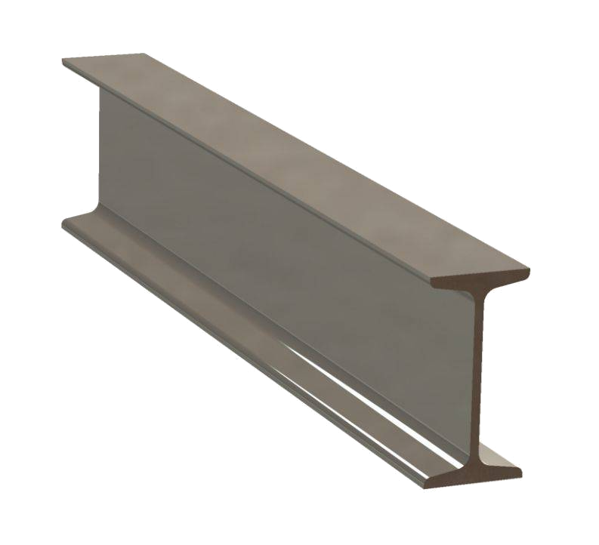
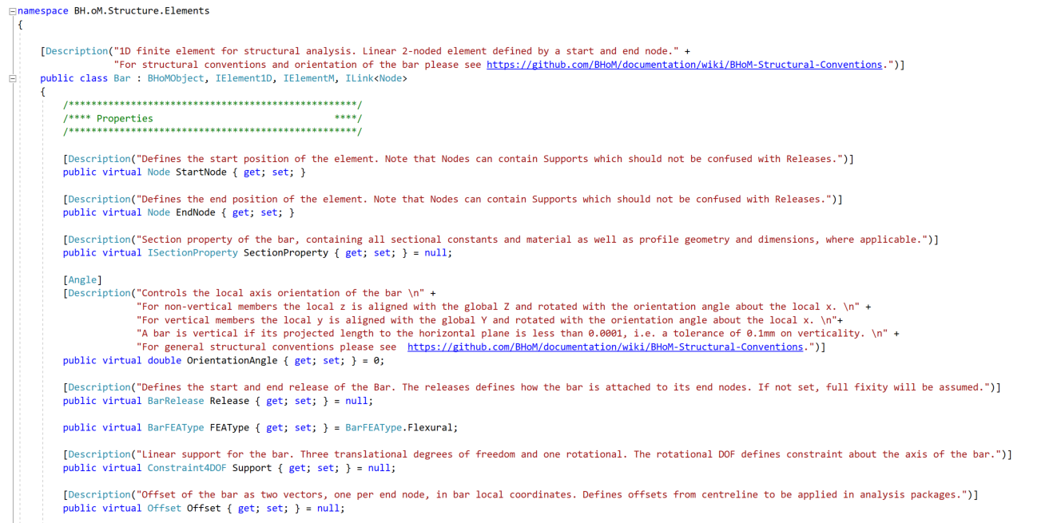
Example: Structure.Elements.Bar
https://github.com/BHoM/BHoM/blob/main/Structure_oM/Elements/Bar.cs

Slide 28
Key Interfaces
…
…
Elements, Materials, Results
IResult
INode, ILink, IPanel …
IGeometry, ICurve, ISurface …
IElement0D, 1D, 2D …
IBHoMObject

Slide 29
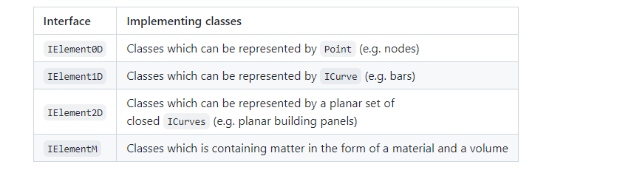
Dimensional_oM IElement Interfaces
https://github.com/BHoM/documentation/wiki/IElement-required-extension-methods

Slide 30
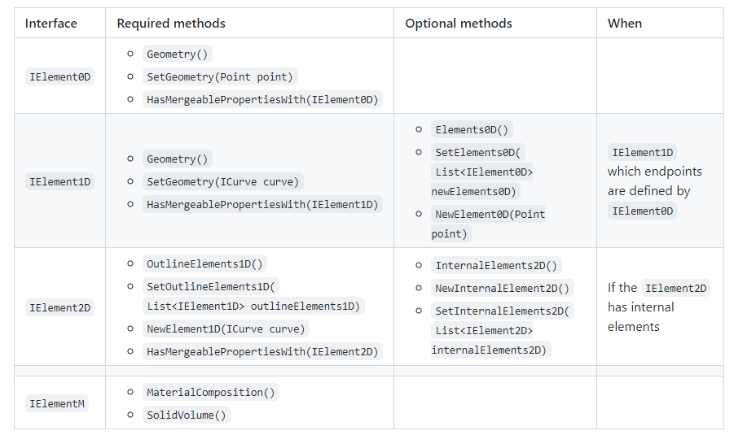
Dimensional_oM IElement Interfaces
https://github.com/BHoM/documentation/wiki/IElement-required-extension-methods

Slide 31
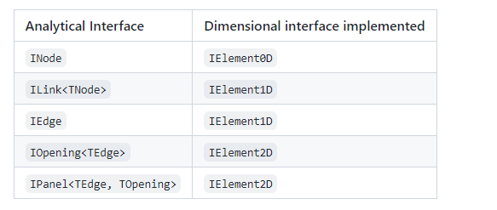
Analytical_oM IElement Interfaces
https://github.com/BHoM/documentation/wiki/IElement-required-extension-methods

Slide 32
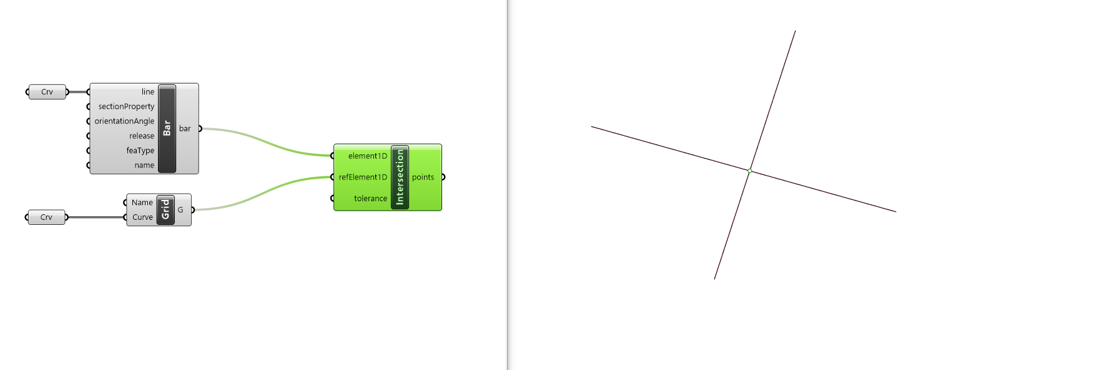
Dimensional Interfaces
https://github.com/BHoM/documentation/wiki/IElement-required-extension-methods

Slide 33
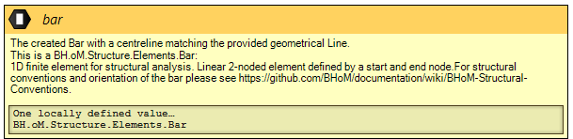
Dimensional Interfaces
https://github.com/BHoM/documentation/wiki/IElement-required-extension-methods

Slide 34
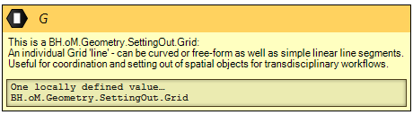
Dimensional Interfaces
https://github.com/BHoM/documentation/wiki/IElement-required-extension-methods

Slide 35
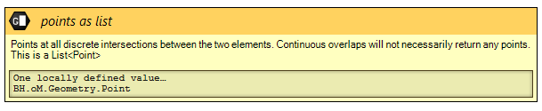
Dimensional Interfaces
https://github.com/BHoM/documentation/wiki/IElement-required-extension-methods

Slide 36
Dimensional Interfaces
https://github.com/BHoM/documentation/wiki/IElement-required-extension-methods

Slide 37
Why all the interfaces on Elements?
Three reasons:
A. Standardising engine methods for performing universal calculations
B. Standardising means for consuming, visualisation and reporting elements
C. Relate multiple representations together, convert and derive relative representations. casting relationships across transdisciplinary elements

Slide 38
Key Interfaces
…
…
Elements, Materials, Results
IResult
INode, ILink, IPanel …
IGeometry, ICurve, ISurface …
IElement0D, 1D, 2D …
IBHoMObject

Slide 39
Quantities_oM
[Description("Dimensional quantity as defined by the International System of Quantities")]
public abstract class QuantityAttribute : InputClassificationAttribute, IImmutable
{
[Description("Length dimension")]
public virtual int L { get; } = 0;
[Description("Mass dimension")]
public virtual int M { get; } = 0;
[Description("Time dimension")]
public virtual int T { get; } = 0;
[Description("Electric current dimension")]
public virtual int I { get; } = 0;
[Description("Temperature dimension")]
public virtual int Θ { get; } = 0;
[Description("Amount of substance dimension")]
public virtual int N { get; } = 0;
[Description("Luminous intensity dimension")]
public virtual int J { get; } = 0;
[Description("SI derived unit symbol")]
public abstract string SIUnit { get; }
}

Slide 40
Quantities_oM
[AttributeUsage(AttributeTargets.Property)]
public class Density : QuantityAttribute
{
/***************************************************/
/**** Properties ****/
/***************************************************/
public override int M { get; } = 1;
public override int L { get; } = -3;
public override string SIUnit { get; } = "kg/m³";
/***************************************************/
}

Slide 41
Quantities_oM
[Description("Structural steel material to be used on structural elements and properties or as a fragment of the physical material.")]
public class Steel : BHoMObject, IIsotropic
{
/***************************************************/
/**** Properties ****/
/***************************************************/
[Description("A unique Name is required for some structural packages to create and identify the object.")]
public override string Name { get; set; }
[Density]
public virtual double Density { get; set; }
[Ratio]
[Description("Dynamic damping ratio, expressed as a ratio between actual damping and critical damping. For structures, typically taken as 0.02 (i.e. 2%).")]
public virtual double DampingRatio { get; set; }
[Ratio]
[Description("Ratio between axial and transverse strain. Used together with YoungsModulus to derive the ShearModulus for isotropic materials.")]
public virtual double PoissonsRatio { get; set; }
[ThermalExpansionCoefficient]
[Description("The strain induced in the material per unit change of temperature.")]
public virtual double ThermalExpansionCoeff { get; set; }
[YoungsModulus]
[Description("Modulus of elasticity of the material. Ratio between axial stress and axial strain.")]
public virtual double YoungsModulus { get; set; }
[Stress]
[Description("The stress required for the material to yield.")]
public virtual double YieldStress { get; set; }
[Stress]
[Description("The stress required for the material to fail.")]
public virtual double UltimateStress { get; set; }

Slide 42
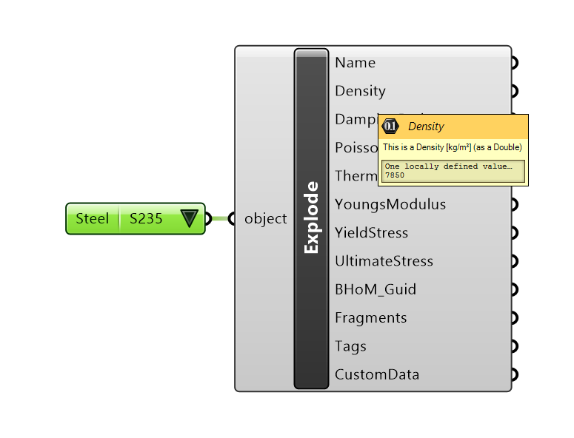
Quantities_oM

Slide 43
Key Interfaces
…
…
Elements, Materials, Results
IResult
INode, ILink, IPanel …
IGeometry, ICurve, ISurface …
IElement0D, 1D, 2D …
IBHoMObject

Slide 44
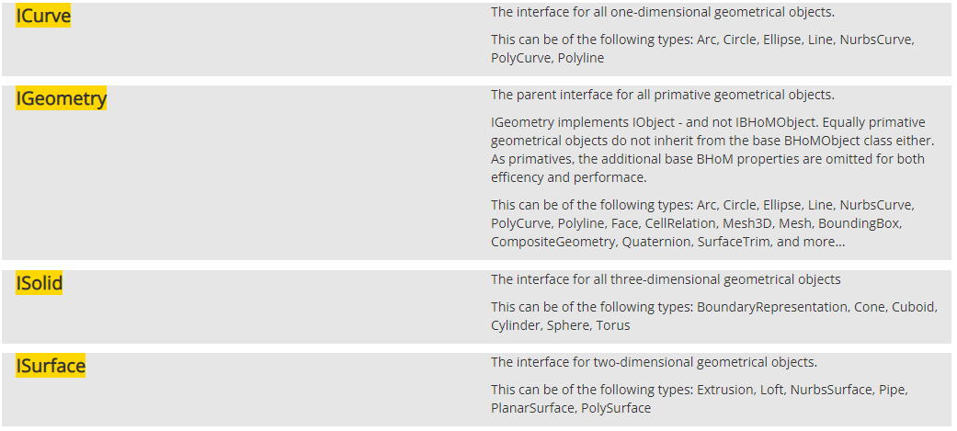
BH.oM.Geometry

Slide 45
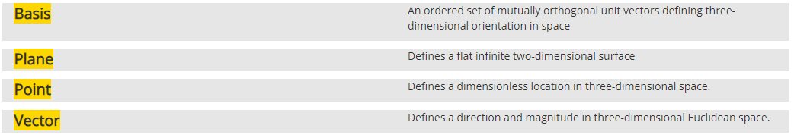
BH.oM.Geometry 0D

Slide 46
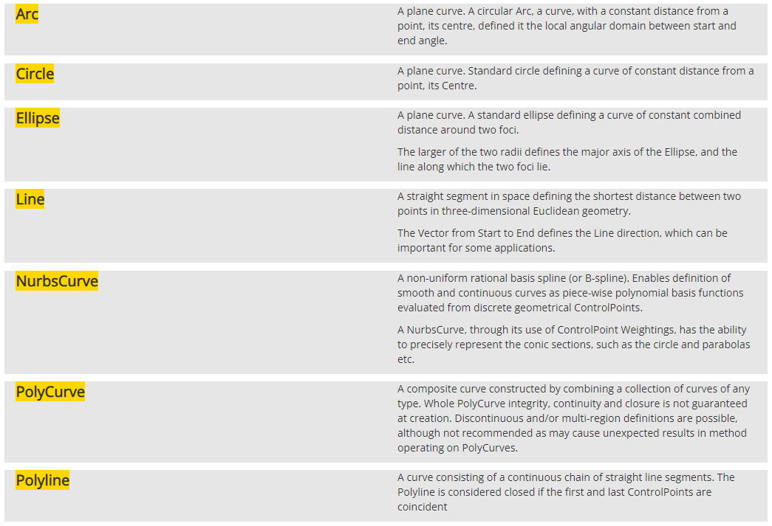
BH.oM.Geometry 1D

Slide 47
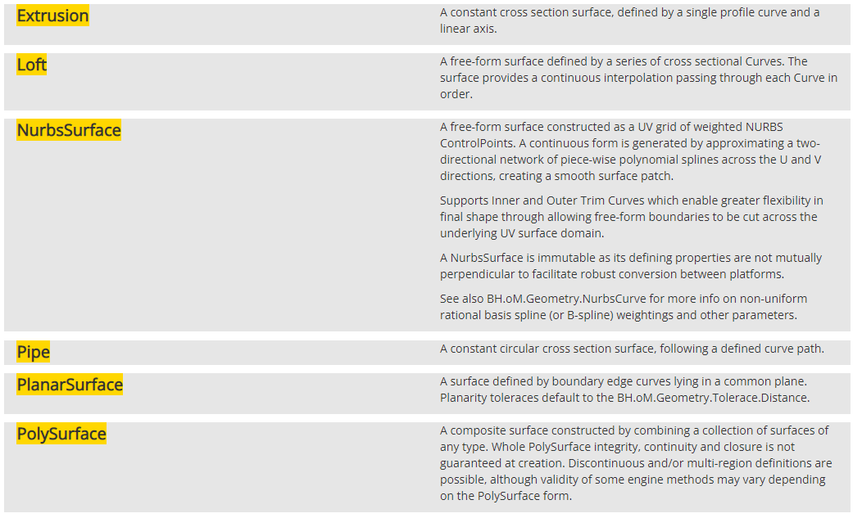
BH.oM.Geometry 2D

Slide 48
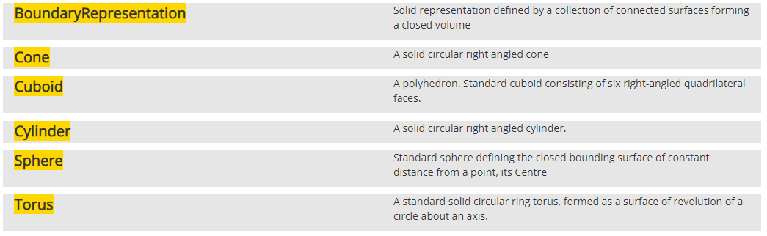
BH.oM.Geometry 3D

Slide 49
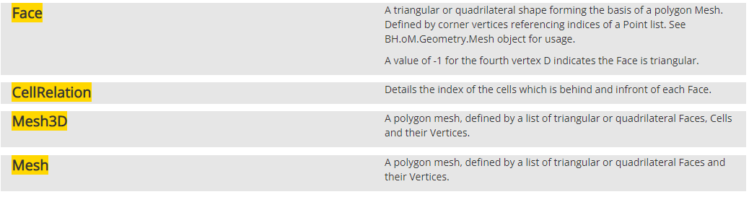
BH.oM.Geometry Mesh

Slide 50
Results and the IImmutable interface
[Description("Base class for all bar result classes. Stores all identifier information and
how to sort the results in a collection.")]
public abstract class BarResult : IStructuralResult, IImmutable
https://github.com/BHoM/documentation/wiki/The-IImmutable-interface

Slide 51
Results and the IImmutable interface
[Description("Resulting section forces in local coordinates along the bar.")]
public class BarForce : BarResult
{
/***************************************************/
/**** Properties ****/
/***************************************************/
[Force]
[Description("Axial force along the local x-axis. Positive for tension, negative for compression.")]
public virtual double FX { get; }
[Force]
[Description("Shear force along the local y-axis. Generally minor axis shear force.")]
public virtual double FY { get; }
[Force]
[Description("Shear force along the local z-axis. Generally major axis shear force.")]
public virtual double FZ { get; }
[Moment]
[Description("Torsional moment.")]
public virtual double MX { get; }
[Moment]
[Description("Bending moment about the local y-axis. Generally major axis bending moment.")]
public virtual double MY { get; }
[Moment]
[Description("Bending moment about the local z-axis. Generally minor axis bending moment.")]
public virtual double MZ { get; }
https://github.com/BHoM/documentation/wiki/The-IImmutable-interface

Slide 52
Key Interfaces
…
…
Elements, Materials, Results
IResult
INode, ILink, IPanel …
IGeometry, ICurve, ISurface …
IElement0D, 1D, 2D …
IBHoMObject

Slide 53
Common object Model (oM)
Total number of objects is currently 1467
Organised across 26 wide ranging disciplines/namespaces:
Acoustic
Analytical
Architecture
Data
Deep Learning
Diffing
Dimensional
Environment
Façade
Geometry
Graphics
Humans
Inspections
Life Cycle Assessment
Lighting
MEP
Physical
Planning
Programming
Quantities
Reflection
Security
Spatial
Structure
Test
Versioning

Slide 54
Elements
IElement0D
BH.oM.Security.Elements.CameraDevice
BH.oM.MEP.Equipment.MechanicalEquipment
BH.oM.MEP.Equipment.ElectricalEquipment
BH.oM.MEP.Fixtures.PlumbingFixture
BH.oM.MEP.Fixtures.LightFixture
BH.oM.MEP.Fixtures.FireAlarmDevice
BH.oM.MEP.Fixtures.ElectricalFixture
BH.oM.MEP.Fixtures.AirTerminal
BH.oM.MEP.System.Dampers.Valve
BH.oM.MEP.System.Dampers.VolumeDamper
BH.oM.MEP.System.Dampers.Damper
BH.oM.MEP.System.Fittings.Fitting
BH.oM.MEP.System.Node
BH.oM.Lighting.Analysis.Node
BH.oM.Lighting.Elements.Luminaire
BH.oM.Structure.Elements.Node
BH.oM.Environment.Analysis.Node
BH.oM.Architecture.BuildersWork.Opening
BH.oM.Graphics.RenderPoint
BH.oM.Geometry.Point
IElement1D
BH.oM.MEP.System.WireSegment
BH.oM.MEP.System.Pipe
BH.oM.MEP.System.FlowSystem
BH.oM.MEP.System.Duct
BH.oM.MEP.System.CableTray
BH.oM.Adapters.GSA.Elements.Spacer
BH.oM.Facade.Elements.FrameEdge
BH.oM.Structure.Elements.Edge
BH.oM.Structure.Elements.Bar
BH.oM.MEP.Fixtures.Sprinkler
BH.oM.Environment.Elements.Edge
BH.oM.Physical.Elements.Pile
BH.oM.Physical.Elements.Column
BH.oM.Physical.Elements.Cable
BH.oM.Physical.Elements.Bracing
BH.oM.Physical.Elements.Beam
BH.oM.Spatial.SettingOut.Grid
BH.oM.Geometry.Polyline
BH.oM.Geometry.PolyCurve
BH.oM.Geometry.NurbsCurve
BH.oM.Geometry.Line
BH.oM.Geometry.Ellipse
BH.oM.Geometry.Circle
BH.oM.Geometry.Arc
IElement2D
BH.oM.Facade.Elements.Panel
BH.oM.Facade.Elements.Opening
BH.oM.Facade.Elements.CurtainWall
BH.oM.Structure.Elements.Panel
BH.oM.Structure.Elements.Opening
BH.oM.Structure.Reinforcement.ReinforcementRegion
BH.oM.Environment.Elements.Zone
BH.oM.Environment.Elements.Space
BH.oM.Environment.Elements.Panel
BH.oM.Environment.Elements.Opening
BH.oM.Physical.Elements.Window
BH.oM.Physical.Elements.Wall
BH.oM.Physical.Elements.Void
BH.oM.Physical.Elements.Roof
BH.oM.Physical.Elements.Floor
BH.oM.Physical.Elements.Door
BH.oM.Architecture.Elements.Room
BH.oM.Architecture.Elements.CeilingTile
BH.oM.Architecture.Elements.Ceiling
BH.oM.Geometry.PlanarSurface

Slide 55
Objects are not useful in isolation

Slide 56
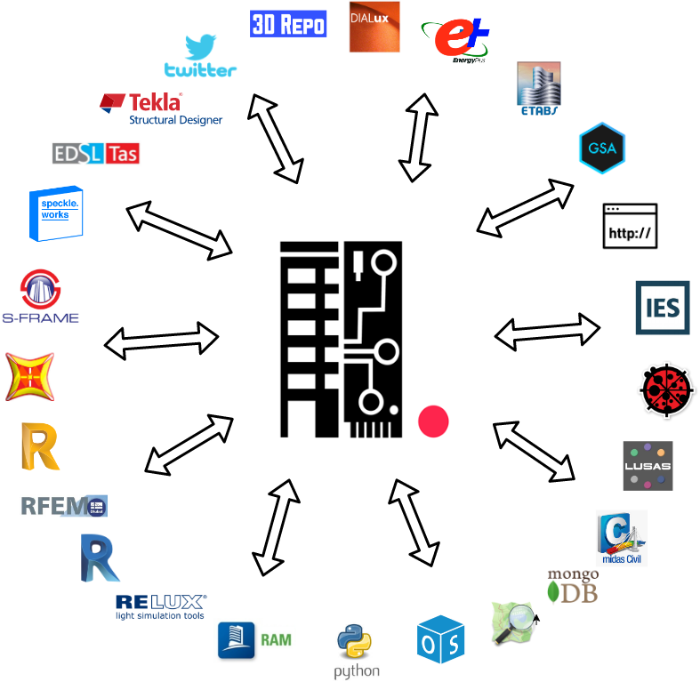






BHoM Adapter Toolkits Interoperability with common oM
36 Open Source Adapters
currently (and growing)

Slide 57
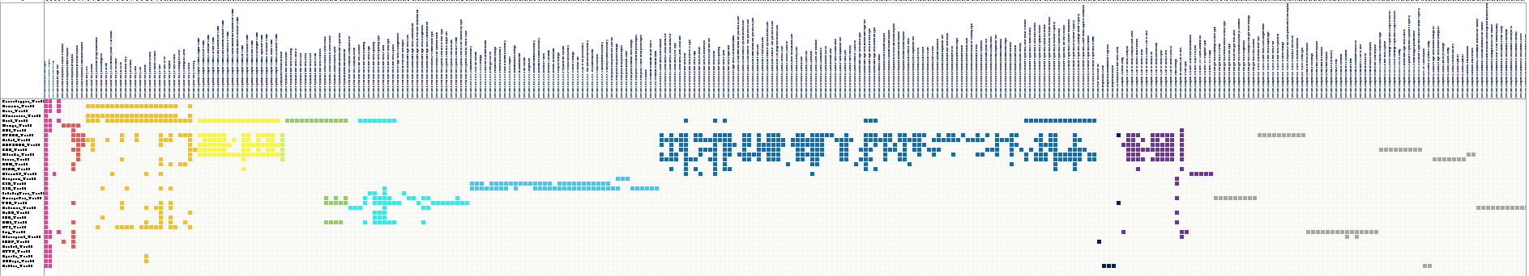












BHoM Adapter Toolkits Interoperability with common oM
…
…
…
…
Geometry
Spatial
Physical
Environment
Structure
Structure.Elements
Loads
Analysis Results
Material Properties

Slide 58
Why all the interfaces on Elements?
Three reasons:
A. Standardising engine methods for performing universal calculations
B. Standardising means for consuming, visualisation and reporting elements
C. Relate multiple representations together, convert and derive relative representations. casting relationships across transdisciplinary elements

Slide 59
A. Standardising engine methods for performing universal calculations
Spatial Engine – Model Laundry
Graph and topology queries - Graphflow
Matter Engine
Life Cycle Assessment
Data processing and analytics

Slide 60







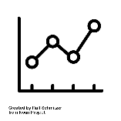
B. Standardising means for consuming, visualisation and reporting elements
IResults
Analytical
Game Engines
+
3D Viewers
+
Dashboards
IGeometry
Geometry
Graphics
Dimensional
IElements
Quantities
Base Object

Slide 61
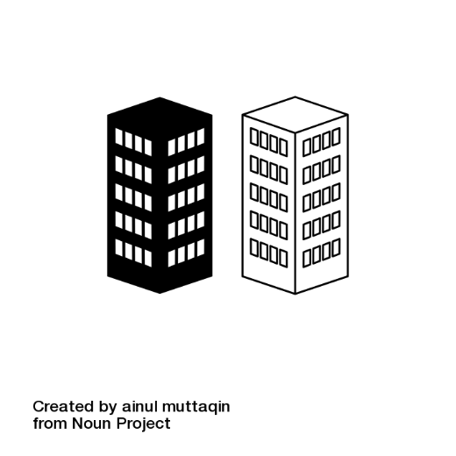

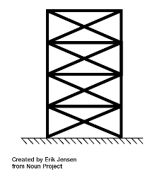
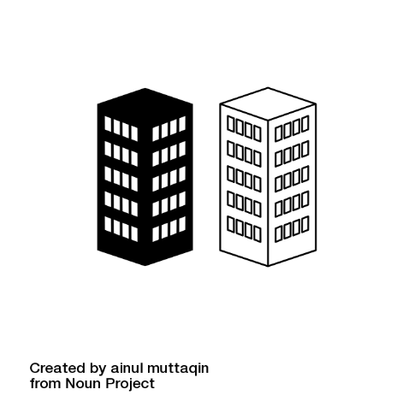


C. Relate multiple representations together, convert and derive relative representations. casting relationships across transdisciplinary elements
Transdisciplinary
Scripts
IModel
ISystem
IElements

Slide 62
How to link single (semi-autonomous) models together
What are we doing now?
What new concepts we need to formalise:
ISpecification (extension of CIH work)
IModel and IControlSystem
IStream (integration with Deltas work)
What is the difference between Physical/Analytical Explicit? Geometrical?
Design coordination happens in Physical/Explict? These are the components used to define Components

Slide 63
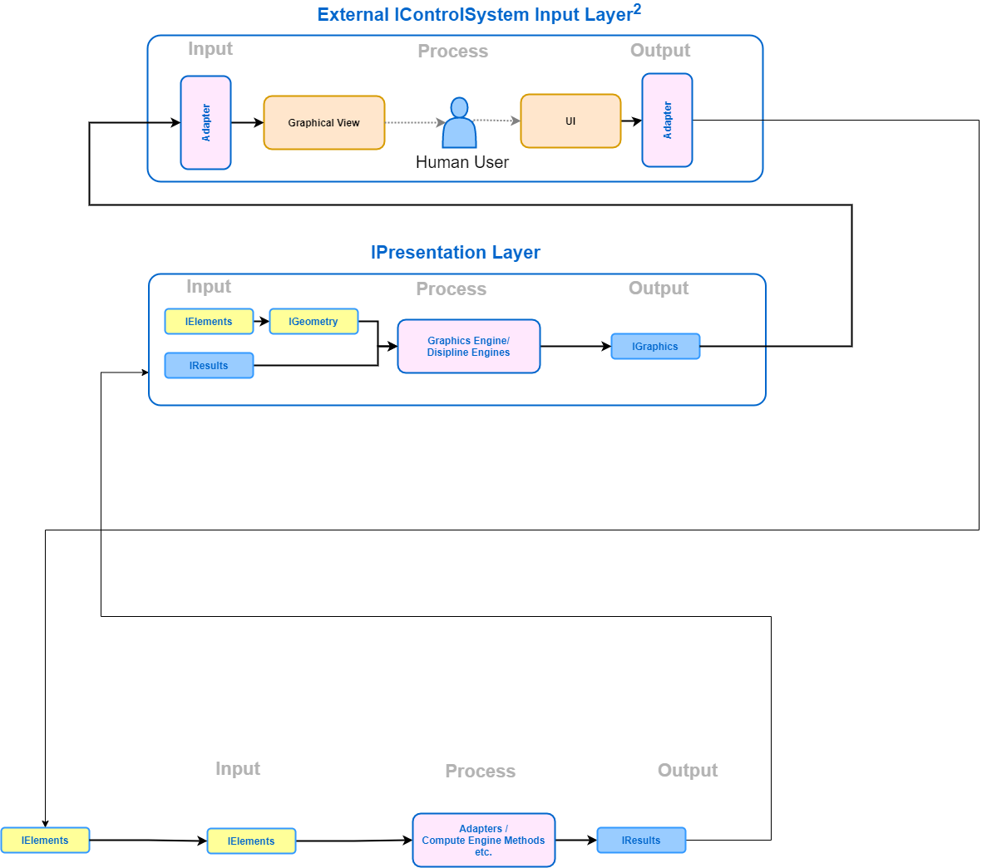
What are we doing now?

Slide 64
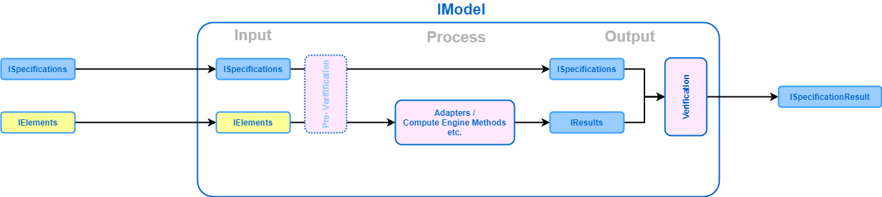
IElement & IResults control systems

Slide 65
IElement & IResults control systems IModel

Slide 66
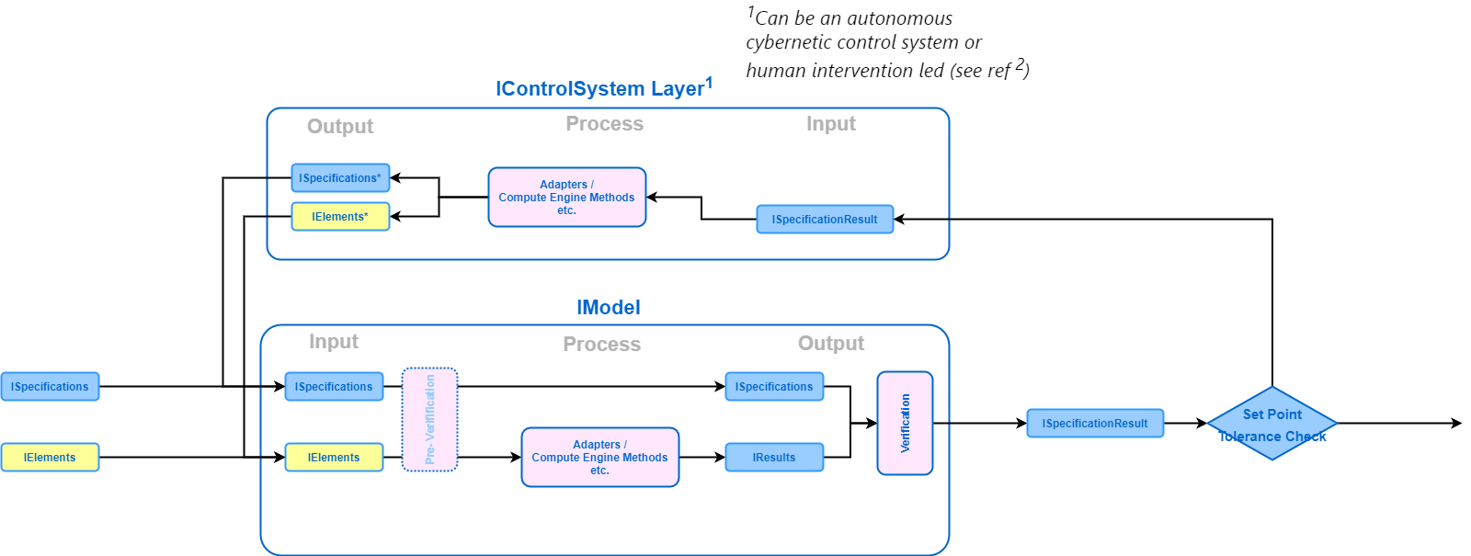
IElement & IResults control systems Iterative/autonomous IModel

Slide 67
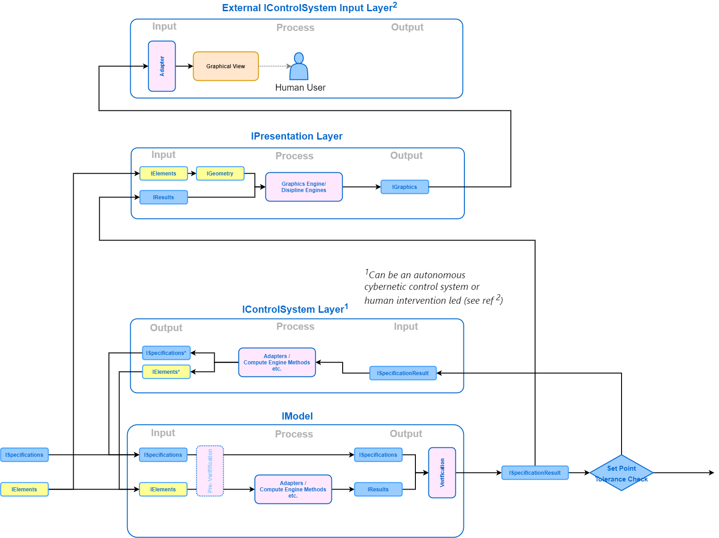
IElement & IResults control systems Iterative/autonomous, with reporting

Slide 68
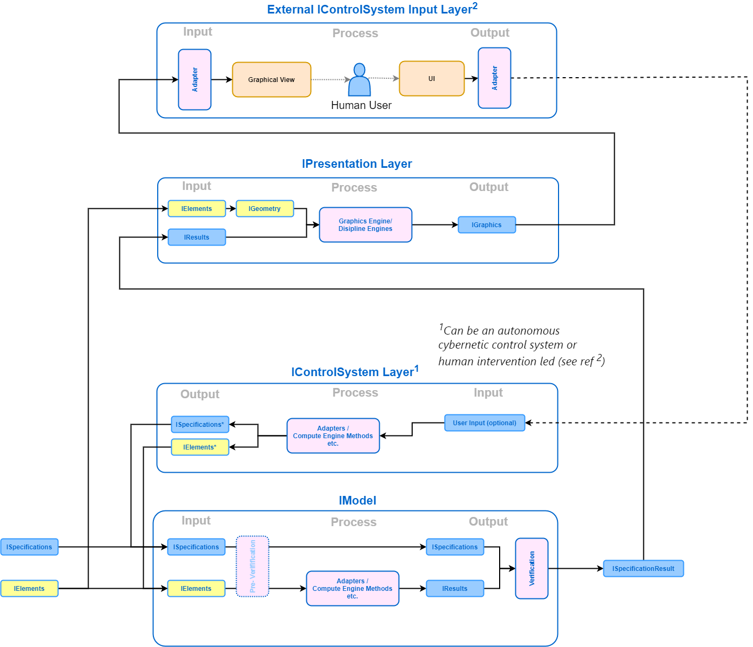
IElement & IResults control systems Iterative/autonomous, with reporting, human control

Slide 69
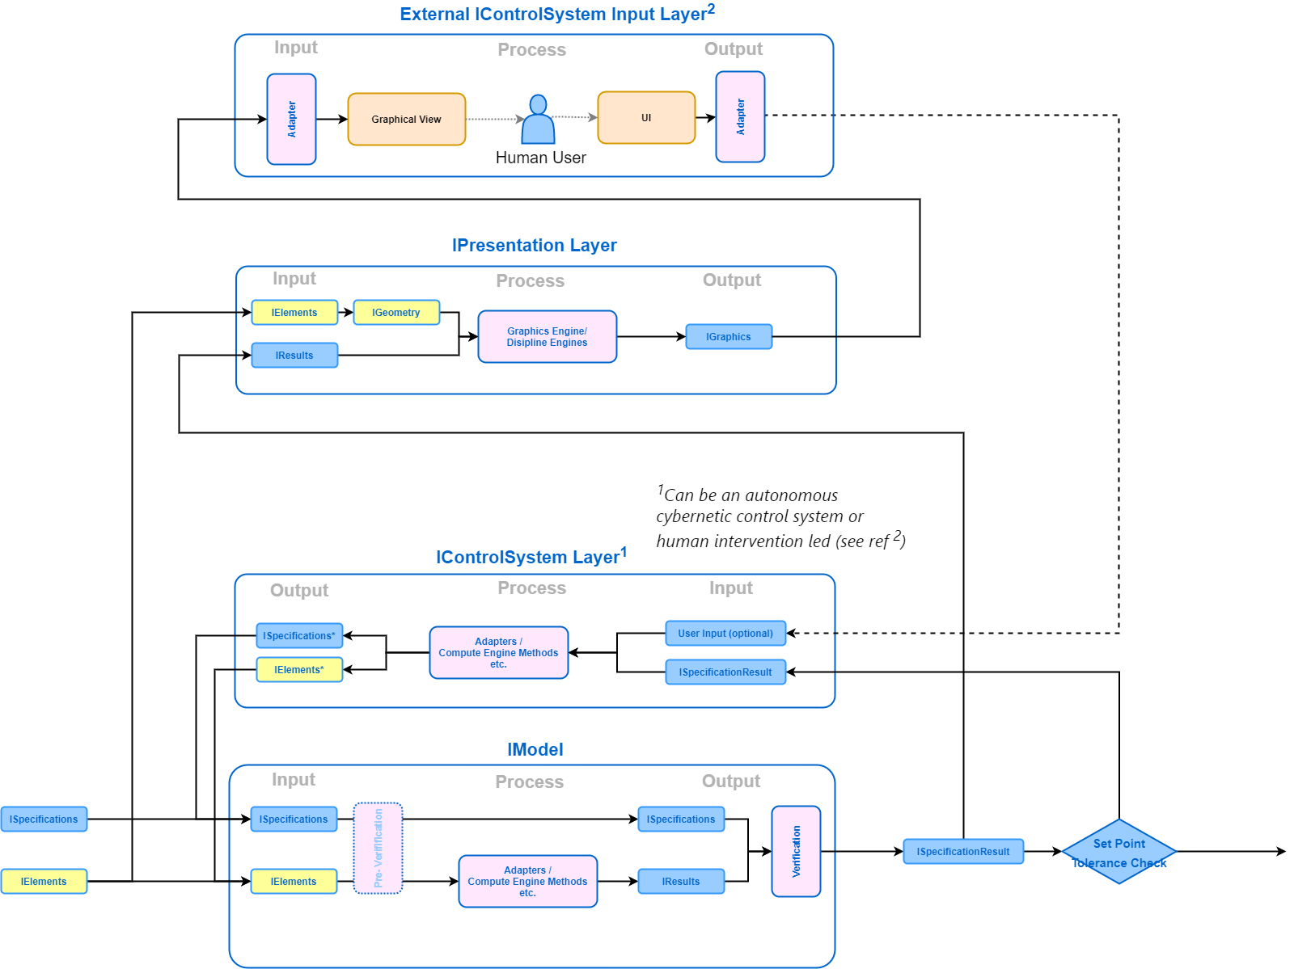
IElement & IResults control systems Iterative/autonomous with reporting + human control

Slide 70
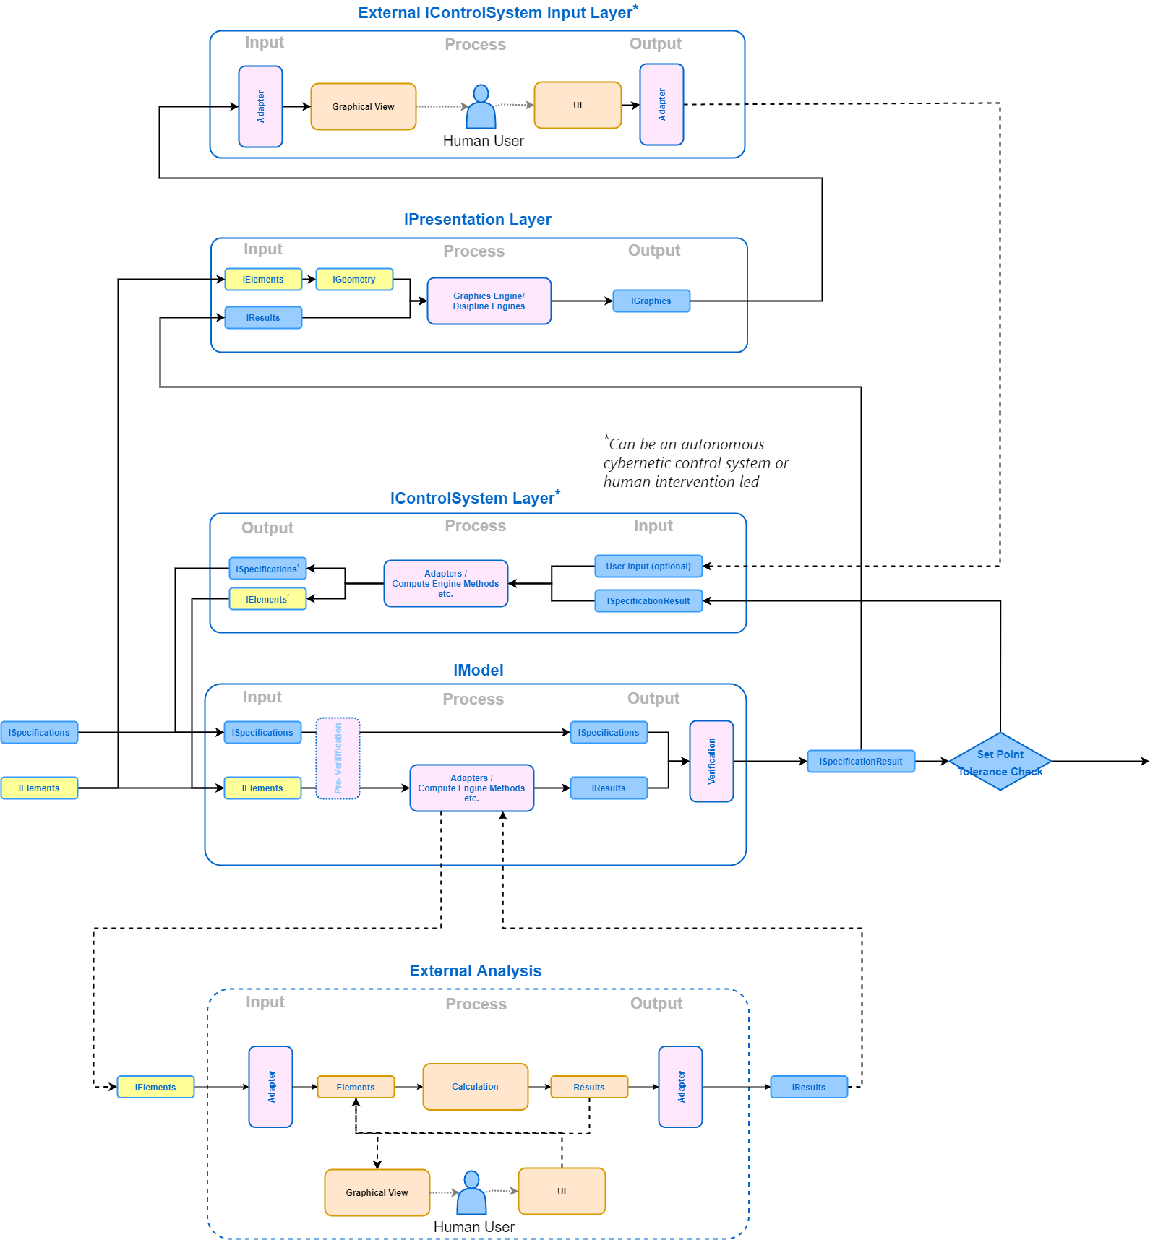
IElement & IResults control systems Iterative/autonomous with reporting + human control

Slide 71
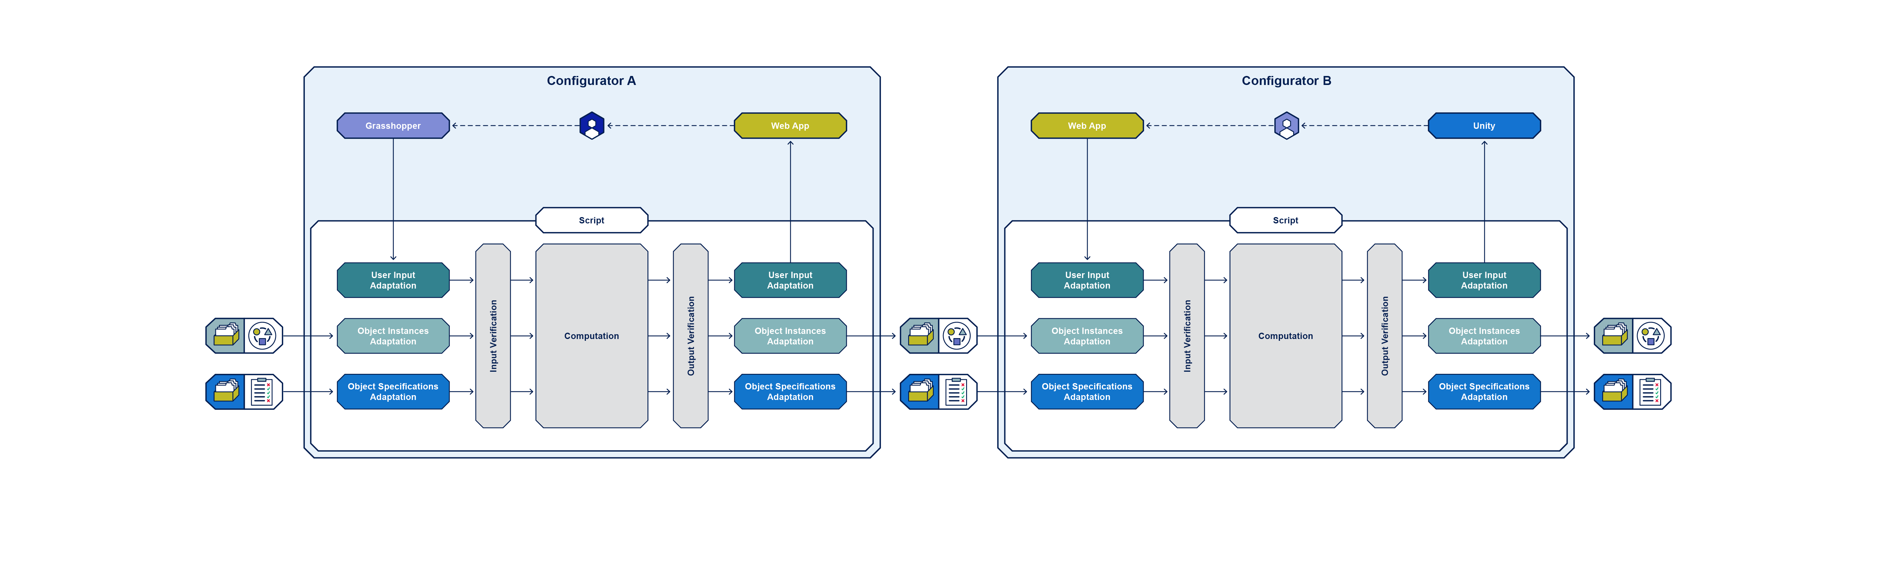
1. Chaining Distributed UIs but with potential for common overlaid central Design Environment
Common Design Environment
one way - output

Slide 72
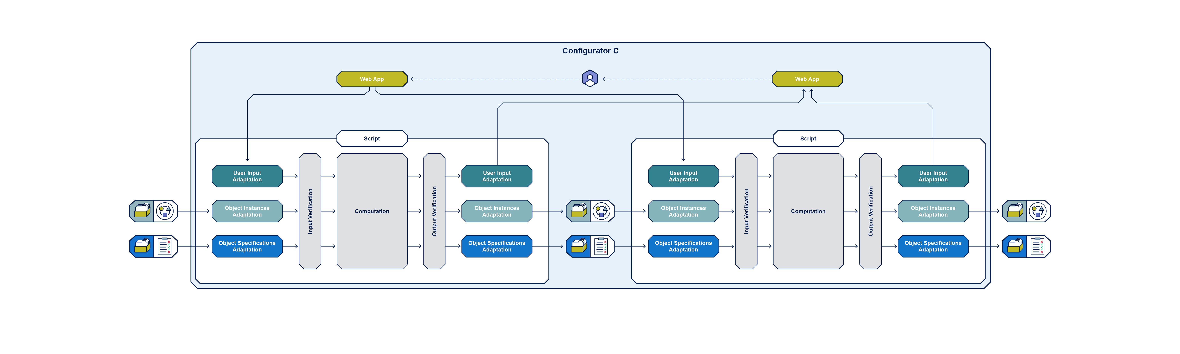

2. Wrapping Centralised UI and Presentation layer driving processes
Common Design Environment

Slide 73
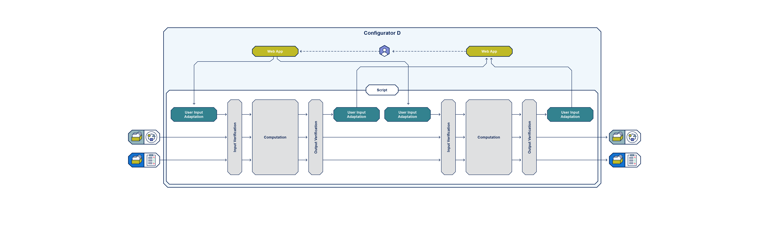
3. Integration Common hosting and processing environment
Common Design Environment

Slide 74
Multiple Design Representations

Slide 75
Rapid Prototyping
Calibration > Building > Experience
BUILDING ELEMENTS
DESIGN PARAMETERS
PERFORMANCE CRITERIA
Specific Project
Link Weightings
Link Weightings
Performance Criterion
Future
Specific Project Work (in planning)
Analysis and Calibration
Calibration (in existence)
Past
Reference 1
Reference Criterion 1
Analysis and Interpretation of Reference Parameters
Mapping of Reference Parameters
Reference 2
Reference Criterion 2
Notes:
No master layout—copy/paste directly from this slide.

Slide 76
Render
Base Condition
Base Parameters
Directly Augment Base Parameters
To achieve
Compliance
Render
Compliance
Composite Parameter
--------
--------
--------
--------
Comparison
Augment Base Parameters
To achieve
Target CP*
Render
Design Options
CP⁰
CP^{1..n}

Slide 77
Render
Base Condition
SITE
Base Parameters
Directly Augment Base Parameters
To achieve
Compliance
Render
Compliance
Composite Parameter A
--------
--------
--------
Comparison
CP⁰
Augment Base Parameters
To achieve
Target CP*
Render
Design Options
weightings
Ref.
ENVIRONMENT
1
Parameters
CP¹
Composite Parameter A
Ref.
ENVIRONMENT
2
Parameters
Composite Parameter A
CP²
Consultation
Calibration
CP^{1..n}
…

Slide 78
Coordinated Computational Development Map
single coordinated platform
3D + data visualisation
game engines
web platform
tools
visual reporting
scripts + workflows
visualisations
engines
engines
analytics
data analytics
adapters
adapters
adapters
oM
oM
oM
code framework
code
datasets
datasets and model libraries
code hosting and deployment
hosting
databases
database architecture and access

Slide 79






Object Instances
Object Specifications
Common Object Schema
Common Repositories
Users
Configurators

Slide 80
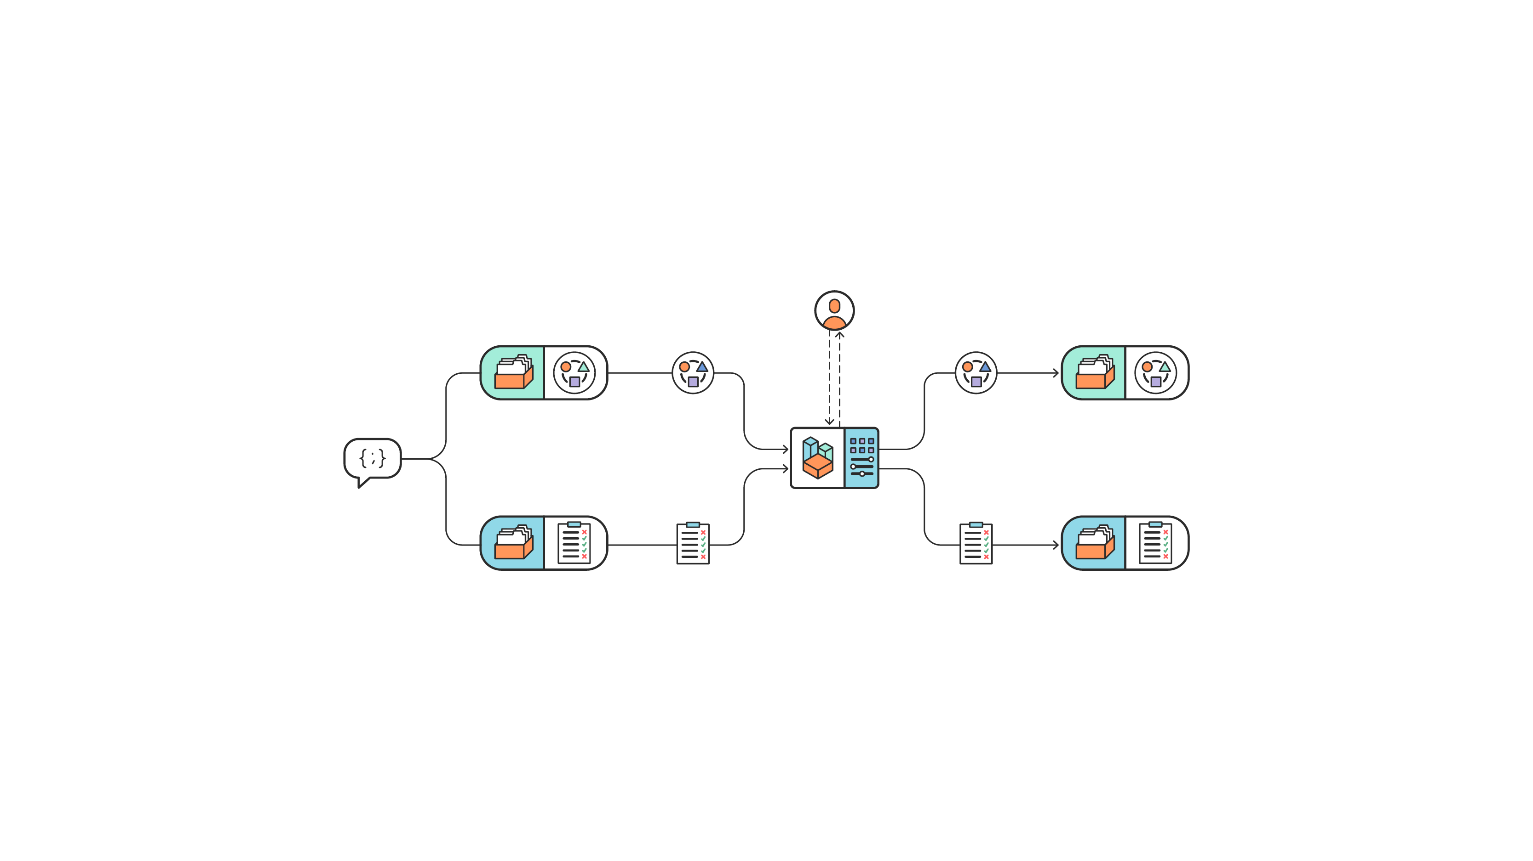
Digital Configurator| Executive Summary
A Configurator as part of a Common Configurator Framework
User
Object Instances Repo
Object Instances Repo
Common Object
Schema
Configurator
Specification Repo
Specification Repo

Slide 81
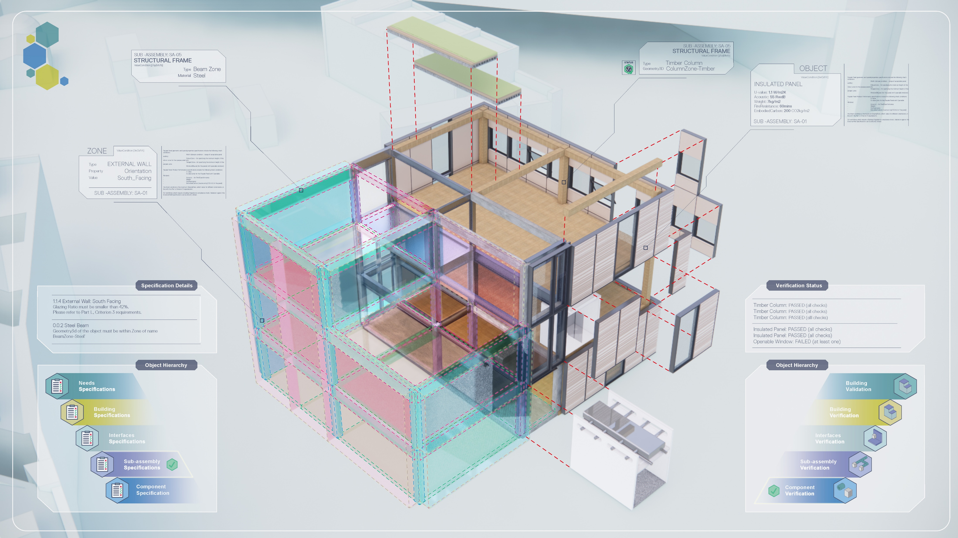



Digital Configurator| Executive Summary
A Configurator as part of a Common Configurator Framework

Slide 82
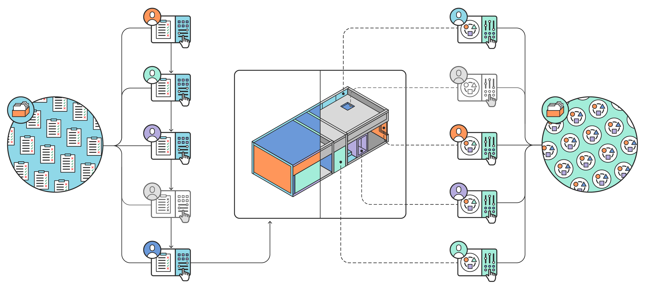

Slide 83


Slide 84
Render
Base Condition
Base Parameters
Directly Augment Base Parameters
To achieve
Compliance
Render
Compliance
Composite Parameter
--------
--------
--------
--------
Comparison
Augment Base Parameters
To achieve
Target CP*
Render
Design Options
CP⁰
CP^{1..n}

Slide 85
Render
Base Condition
SITE
Base Parameters
Directly Augment Base Parameters
To achieve
Compliance
Render
Compliance
Composite Parameter A
--------
--------
--------
Comparison
CP⁰
Augment Base Parameters
To achieve
Target CP*
Render
Design Options
weightings
Ref.
ENVIRONMENT
1
Parameters
CP¹
Composite Parameter A
Ref.
ENVIRONMENT
2
Parameters
Composite Parameter A
CP²
Consultation
Calibration
CP^{1..n}
…

Slide 86








Use Rebar 4.0 as example
Ledger GUIDS
ETABS
ETABS
Slab
Results
Structure
Structure
Structure
Structure
Panel
Results
Rebar Intent
Rebar
Physical
Physical
Fabrication
Site Survey
Floor
3D Rebar
3D Rebar
3D Rebar
Revit
Slab
IFC
Rebar
How do these representations all relate? Cross reference each other?
Rebar
3DRepo
Cares Cloud
Revit
Rebar
IFC
Slab

Slide 87


Slide 88


IFC Beam | BH.oM.Physical.Beam | BHoM.Structure.Bar | Etabs Bar | Rebartek | Site
idfjreerwr | reerw | 32434 | 45 | 54454 | 8889
Element

Slide 89
Notes
USD
Bar – Analytical - ILink
FramingElement – Geometrical – ICurve
Both are IElement1D
Explit (

